Slide 1
Module 1:
Understanding basic concepts

Slide 2
Conflict

Slide 3
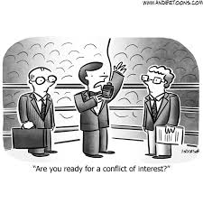
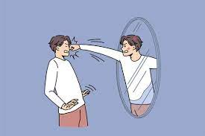
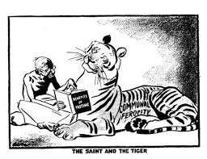
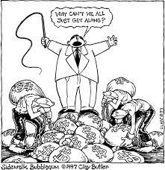
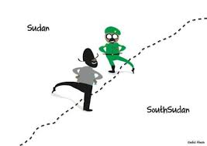
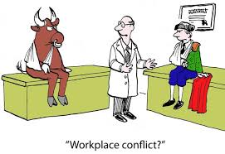
Conflicts

Slide 4
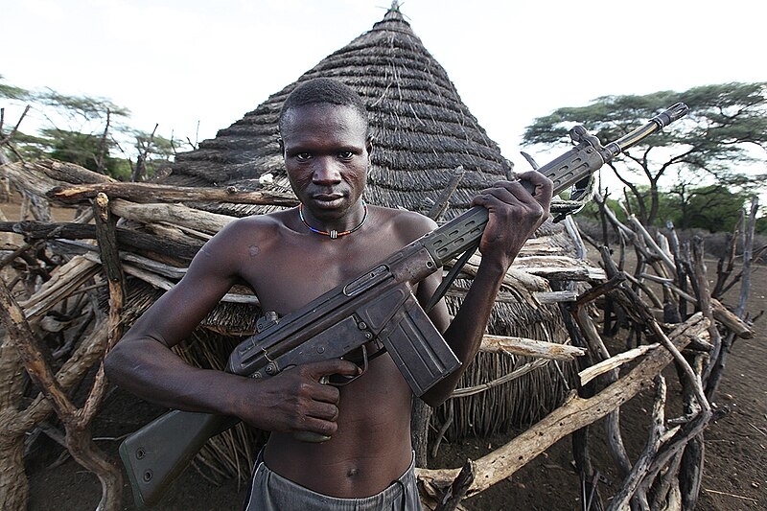

Slide 5
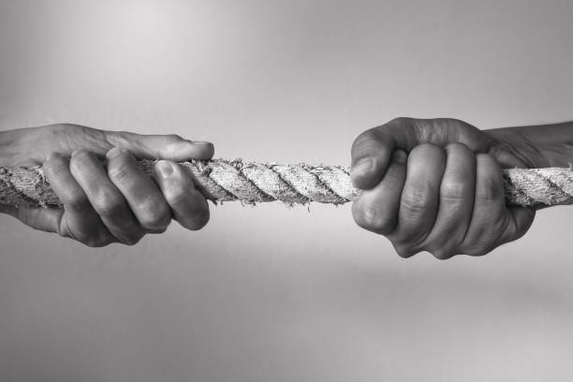
Conflict
When parties (individuals, groups, communities or institutions) have incompatible goals & interests
Is a natural part of any society. It is not necessarily negative, can also have positive results
Often emanates from identity, resources or power

Slide 6
Understanding ‘conflict’
1. Conflict is natural, and happens in the context of a relationship (whether human or cultural, or institutional)
2. Different types of conflict exist, from internal conflict and basic misunderstandings through to civil wars with high levels of death and destruction
3. Parties in conflict often tend to see or emphasise only a part of the truth/facts
4. Parties choose responses to conflict, based on different opinions, experiences, cultures, attitudes, interests, etc (response doesn’t have to be violent)
5. Conflict can be a good catalyst for positive change

